Slide 1

Belgium Real Estate Market Analysis
A comprehensive data-driven exploration of Belgium's property market, examining pricing dynamics, regional variations, and key drivers across 16,000 real estate listings.

Slide 2

The team segmented by property type
Project Overview
Research Objectives
Team Structure
Our analysis examines Belgium's real estate landscape using 16,000 listings from Immovlan. We identify key price drivers, detect market outliers, and explore regional differences across property types including houses, apartments, and commercial properties.
Fred
Regional mapping
Pierrick
Correlation analysis
Brigi
Apartment insights
Esra
House analysis
Astha
Commercial properties

Slide 3

Dataset Description
Our comprehensive dataset encompasses 16,000 property listings across Belgium from Immovlan
Location Data
Core Metrics
Property Features
Province and city identifiers
Property type categories
Bedrooms and bathrooms
Postal code mapping
Price and price per m²
Terrace and garden dimensions
Regional classifications
Livable and land surface areas
Furnished status, facades, garage, pool

Slide 4
Data Cleaning Methodology
Standardization & Formatting
Missing Value Treatment
Converted all numeric columns including price, surface areas, and room counts to proper numeric formats.
Removed rows with missing core variables essential for analysis. Applied median imputation for minor missing numeric values to preserve dataset integrity while maintaining statistical validity.
Outlier Detection
Feature Engineering
Employed multiple detection methods:
Z-Score using 3-Sigma rule,
and custom domain-specific thresholds tailored to real estate market characteristics.
Created derived metrics including price per square meter calculations, enabling standardized comparisons across properties of varying sizes and facilitating deeper market insights.

Slide 5
Overall Price Distribution
*Insert FRED’s price map here*

Slide 6
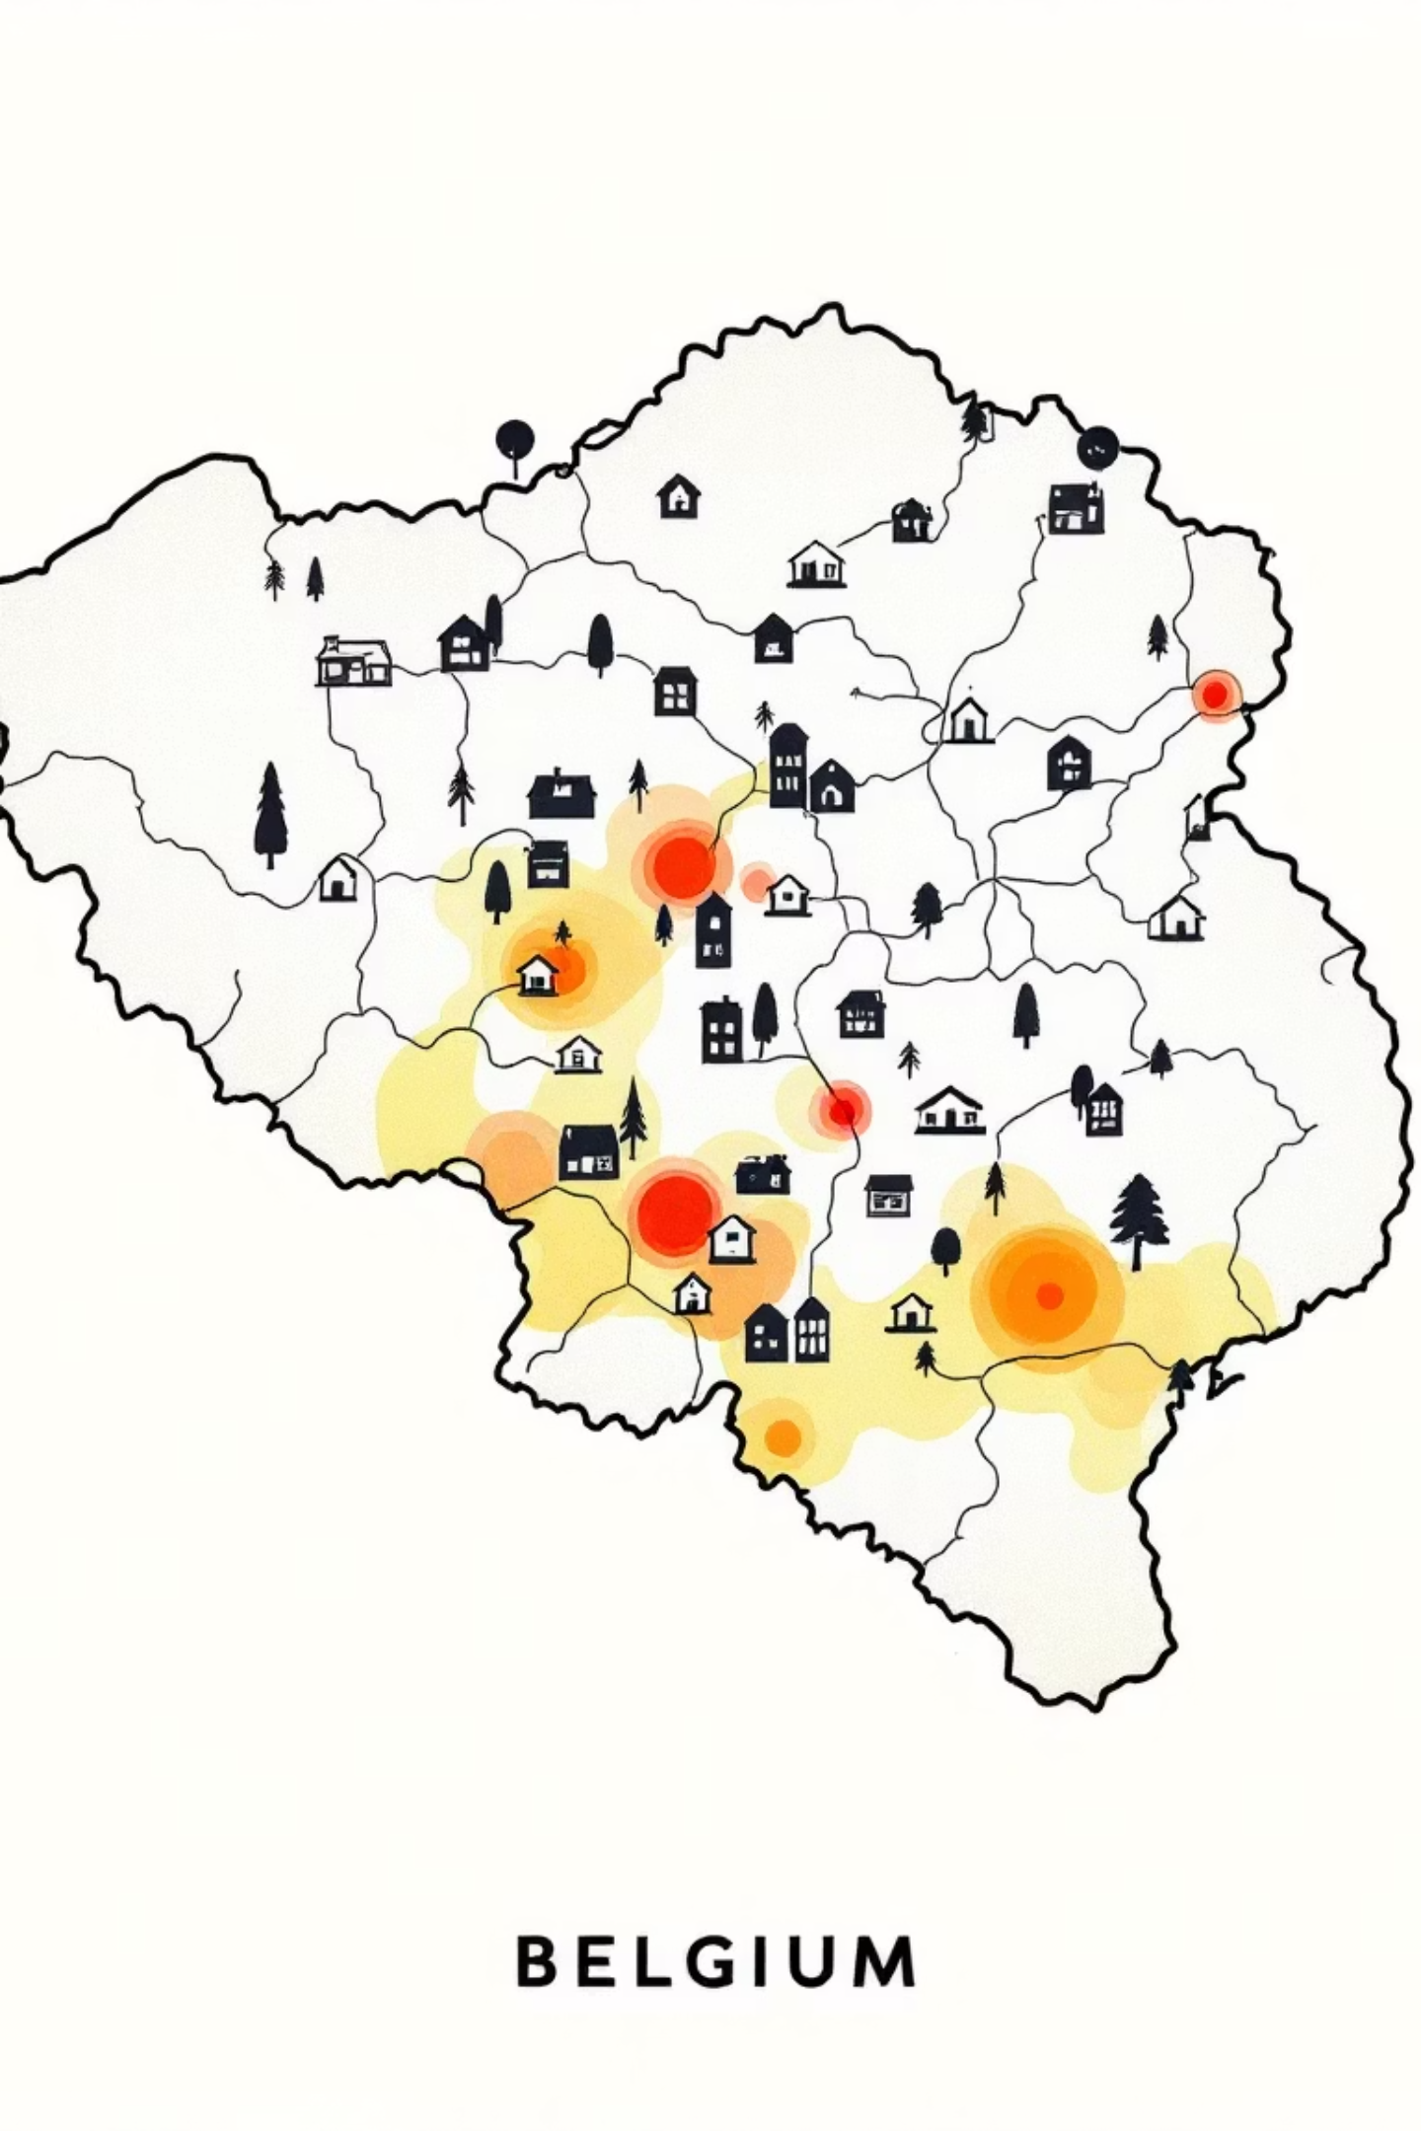
Geographic Price Distribution
This spatial visualization reveals distinct pricing patterns across Belgium's provinces and municipalities. Urban centers like Brussels, Antwerp, and Ghent command premium prices, while rural areas show more moderate valuations.
Urban Premium Zones
Regional Variations
Major cities demonstrate 30-50% higher average prices compared to surrounding regions, driven by employment opportunities and amenities.
Flanders, Wallonia, and Brussels Capital Region each display unique pricing characteristics influenced by local economic conditions.
Emerging Markets
Secondary cities and commuter towns show growing price momentum as buyers seek value alternatives to major urban centers.

Slide 7
Correlation Analysis
*Insert Pierrick’s price map here*

Slide 8

Correlation Analysis
Key Relationships
Insights
The correlation matrix reveals which property attributes most strongly influence pricing. Livable surface area shows the strongest positive correlation with price, followed by number of bedrooms and bathrooms.
Location variables (province, city) demonstrate significant correlation strength. Additional features like terraces, gardens, and garages show moderate positive correlations, validating their role as value drivers.

Slide 9

Apartment Market Insights

Slide 10
Apartment Analysis
*Insert Brigi’s price map here*

Slide 11
House Market Insights
Urban Concentration
Price Drivers
Feature Premium

Slide 12

House Market Dynamics
Suburban Demand
Garden Premium
Size Matters
Houses concentrate in suburban and rural areas, with land surface area emerging as a critical price determinant beyond livable space.
Properties with gardens command significant premiums, particularly in family-oriented markets. Garden size correlates strongly with overall property value.
House prices show stronger correlation with total plot size than apartments. Larger properties with 4+ bedrooms dominate premium pricing segments.
The house segment demonstrates distinct buyer preferences compared to apartments, with emphasis on outdoor space, privacy, and
room for families to grow.

Slide 13
House Analysis
*Insert Esra’s price map here*

Slide 14
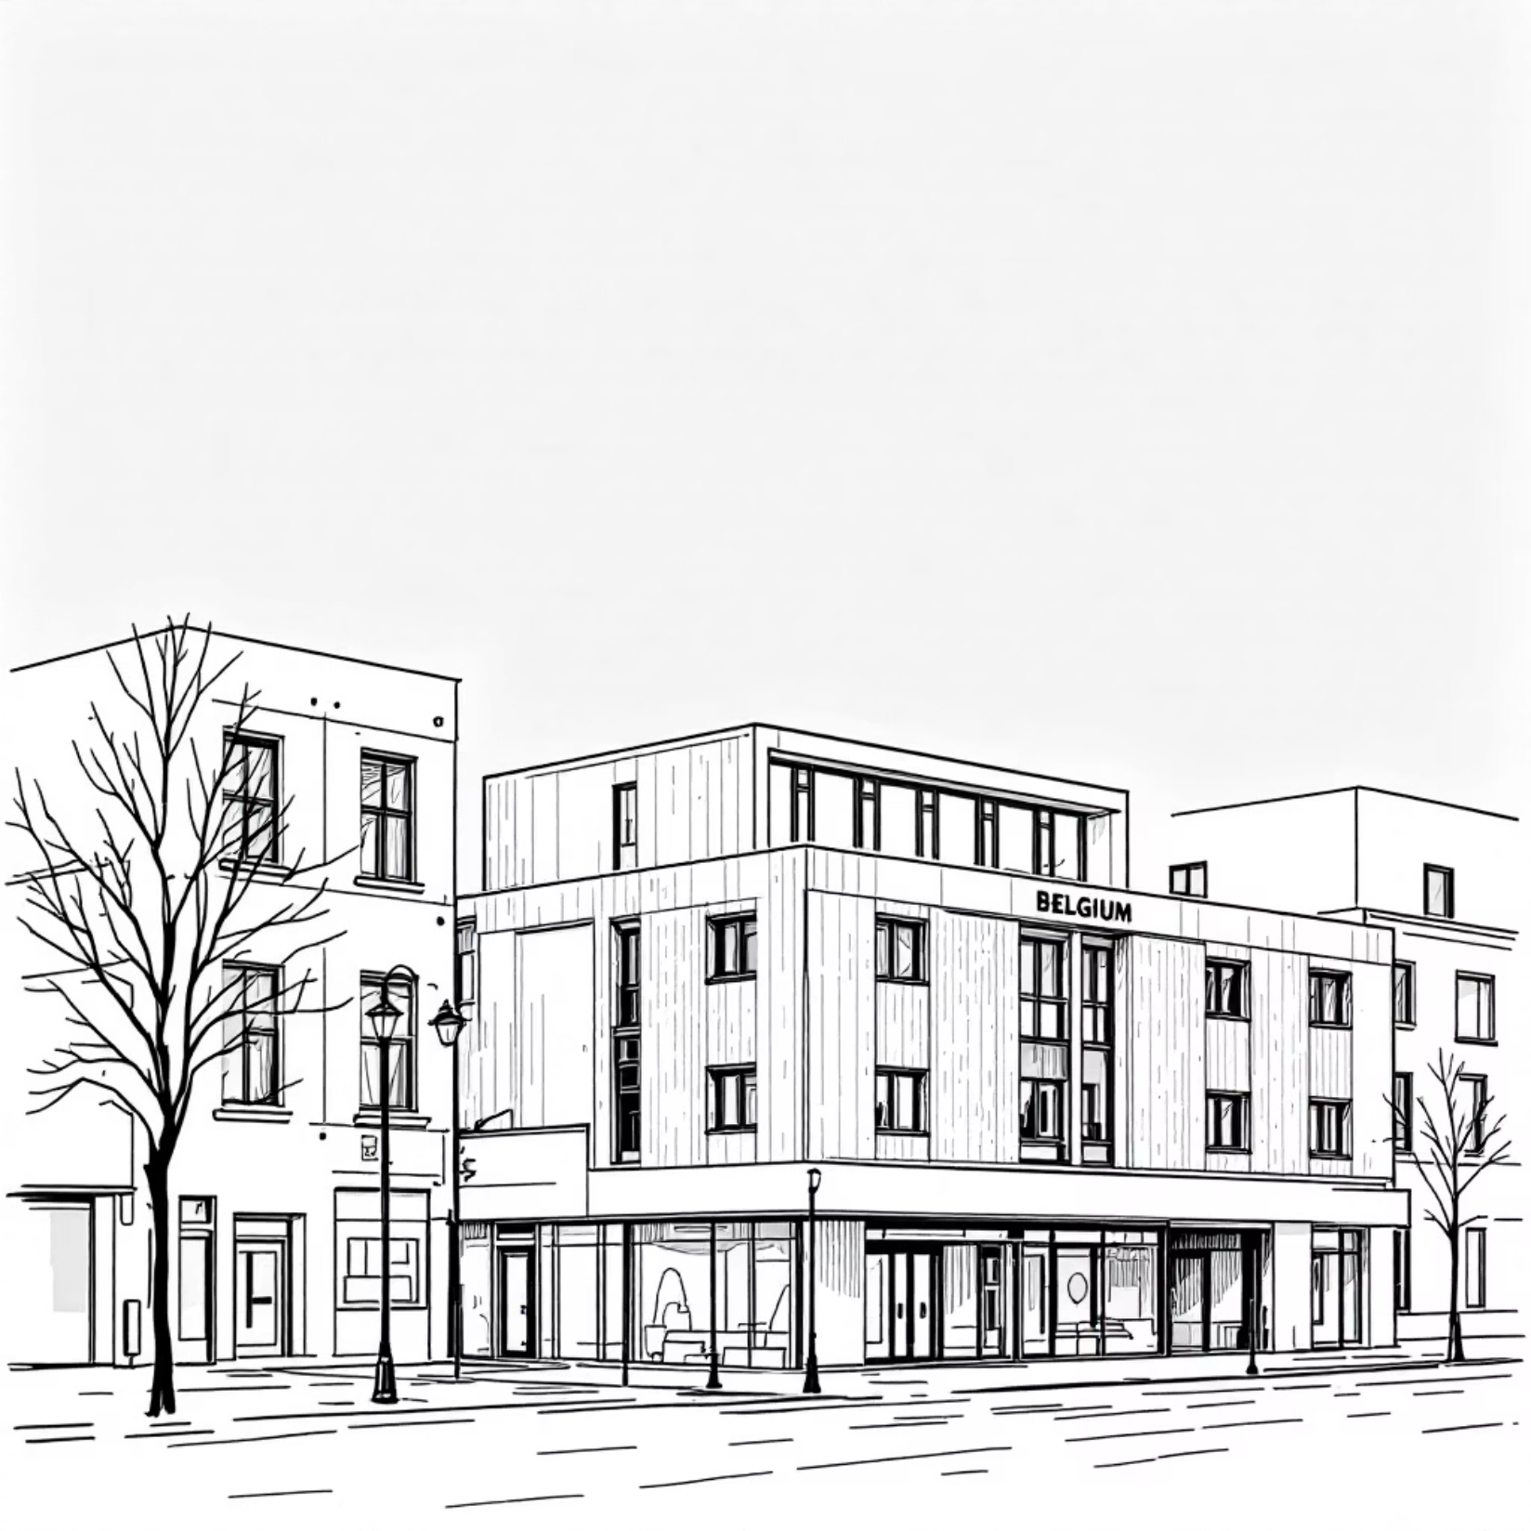
Commercial & Land Analysis
Market Characteristics
Commercial Property Trends
Land Valuations

Slide 15
Commercial & Land Analysis
*Insert Astha’s price map here*

Slide 16
Garage & Features Analysis
Understanding how physical amenities impact property valuations reveals critical pricing patterns
across Belgium's diverse real estate landscape.
Garage Count
Garden & Outdoor Space
Properties with multiple garage spaces command significant premiums, particularly in urban centers where parking is scarce. Each additional garage adds measurable value to overall property price.
Garden presence substantially increases property appeal and pricing, with larger outdoor areas correlating strongly with premium pricing in suburban and rural markets.
Terrace & Balcony
Swimming Pool
Terrace availability adds considerable value, especially in apartment segments. Properties with quality outdoor living spaces consistently outperform comparable listings without these features.
Pool presence signals luxury positioning and dramatically affects pricing, though the impact varies significantly by property type and regional climate preferences.

Slide 17
Key Insights Across All Property Types
Livable Surface: The Primary Price Driver
Provincial Clustering Reveals Geographic Inequality
Square footage of livable space emerges as the strongest predictor of property value, consistently outweighing other factors across all property categories and regions.
Province location creates distinct price clusters, with substantial variations between regions. Clear geographic disparities highlight the importance of location-based modeling approaches.
Property Type Sensitivity Patterns
Bedroom Count: Diminishing Returns Effect
Houses demonstrate higher sensitivity to land surface area, while apartments show greater responsiveness to precise location factors. These distinct behaviors require separate analytical frameworks.
Additional bedrooms increase property value, but the marginal impact decreases with each successive room. The relationship follows a logarithmic rather than linear pattern.
Extreme Value Impact
Distinct Property Behaviors
Outlier properties significantly distort market averages. Strategic filtering of extreme values is essential for accurate baseline modeling and meaningful market analysis.
Business properties and land parcels operate under fundamentally different market dynamics compared to residential real estate, requiring independent analytical approaches.

Slide 18
Strategic Recommendations
01
02
03
Segment ML Models by Property
Category
Leverage Top Correlation Features
Isolate Luxury Market Segment
Prioritize surface area, land dimensions, bedroom count, property type classification, and precise location coordinates as primary model inputs for maximum predictive accuracy.
Maintain extreme values as a dedicated dataset for luxury market analysis, enabling specialized insights into high-end property dynamics without distorting mainstream models.
Build separate machine learning models for houses, apartments, and land/business properties to capture their unique pricing dynamics and feature sensitivities.

